Slide 1
A Seminar on Image Dehazing using Computer Vision and Image Processing
Team Details
Mogili Archana (20EG105601)
B. Hrushikesh (20EG105603)
A. Chandana Gowri (20EG105640)
Project Supervisor
Name Dr. P. Nagaraj
Designation Assistant Professor

Slide 2
Introduction
Haze makes pictures and videos blurry and hard to see details. Existing ways to remove haze are using mathematical calculations or traditional approaches. They result in colour distortion and inconsistent haze removal.This project introduces a new tool called "Patch-map-based hybrid learning DehazeNet" that solves these problems. It combines two clever approaches: hybrid learning and Dehazenet. It also uses a special method called "patch map" to choose the right tools for different parts of the picture.The result is a tool that removes haze better than the traditional ones, making videos clearer and easier to see. It can be used for different things like watching security cameras, helping cars see in fog, and taking pictures from planes.

Slide 3
Problem Statement
Images captured in hazy environments often suffer from poor visibility and missing information, posing a significant challenge for computer vision applications. Over the years, researchers have developed both learning-based and handcrafted prior-based dehazing algorithms to address these issues. However, these algorithms exhibit certain weaknesses in terms of their haze removal performance. Existing methods, such as dark channel prior (DCP) based approaches, have limitations that hinder their effectiveness. For instance, DCP may encounter challenges like color distortion and the inability to recover images involving white scenes. Additionally, traditional learning-based algorithms may struggle to achieve optimal performance in all scenarios.

Slide 4
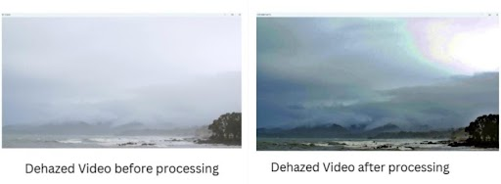
Proposed Method
We present a novel solution, the patch-map-based hybrid learning DehazeNet, to address shortcomings our method introduces a patch map for adaptive patch size selection. Analyzing DCP limitations, we embed a patch-map-based DCP module, enhancing color fidelity and improving recovery of images with white scenes. Simultaneously trained with atmospheric light generation and refinement modules, our hybrid approach achieves superior haze removal. Experimental results demonstrate its effectiveness, outperforming state-of-the-art algorithms and offering a versatile solution for diverse hazy scenarios.

Slide 5
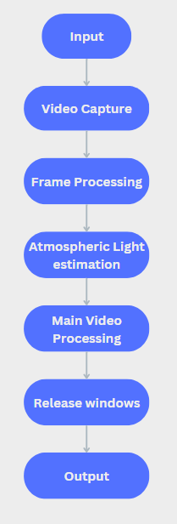
Proposed Method
Hazy video as an input
The program starts by opening the input hazy video using cv2.VideoCapture.It checks if the video is opened successfully.
A loop is initiated to go through each frame of the video.
The program estimates the atmospheric light based on the maximum pixel values of the first frame.
Another loop is initiated to go through each frame of the video.
After processing, the program releases the video capture object and closes all OpenCV windows.
Dehazed video as our output
Illustration :

Slide 6
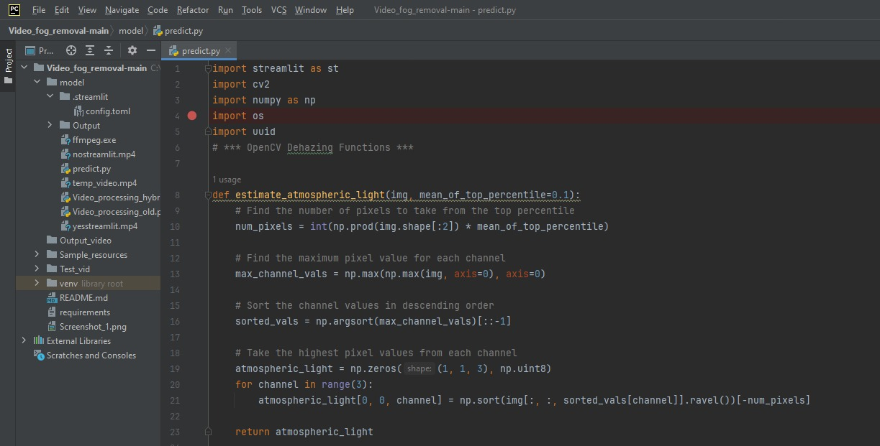
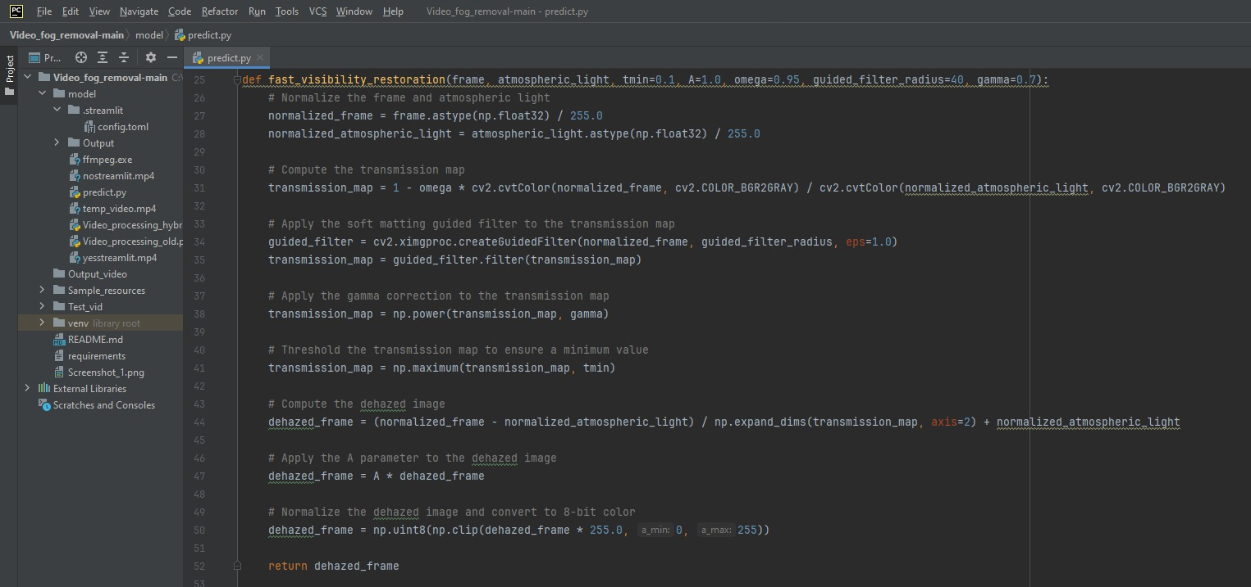
Experiment Environment

Slide 7
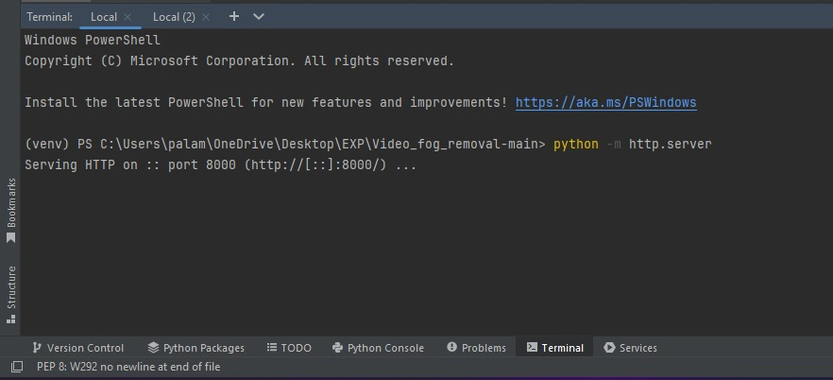
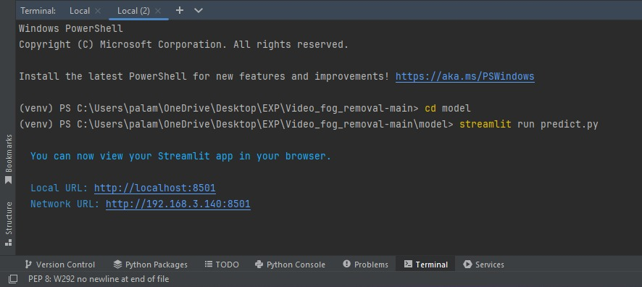
Experiment Screen shorts

Slide 8
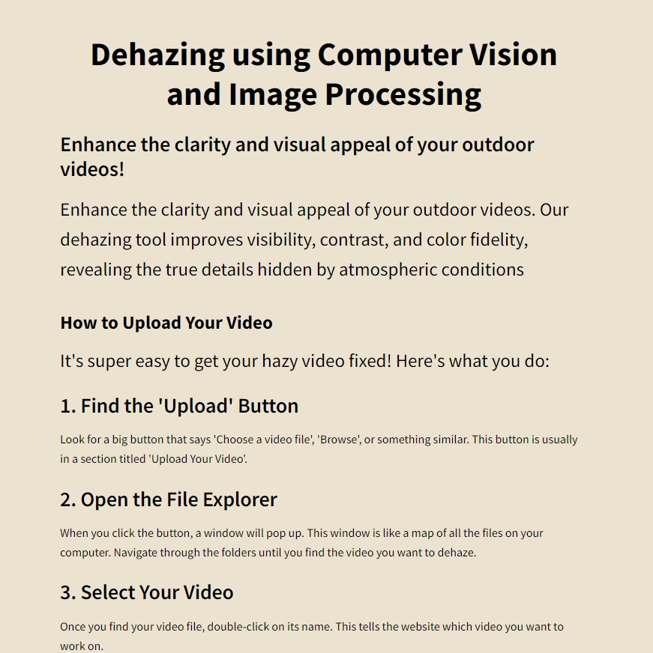
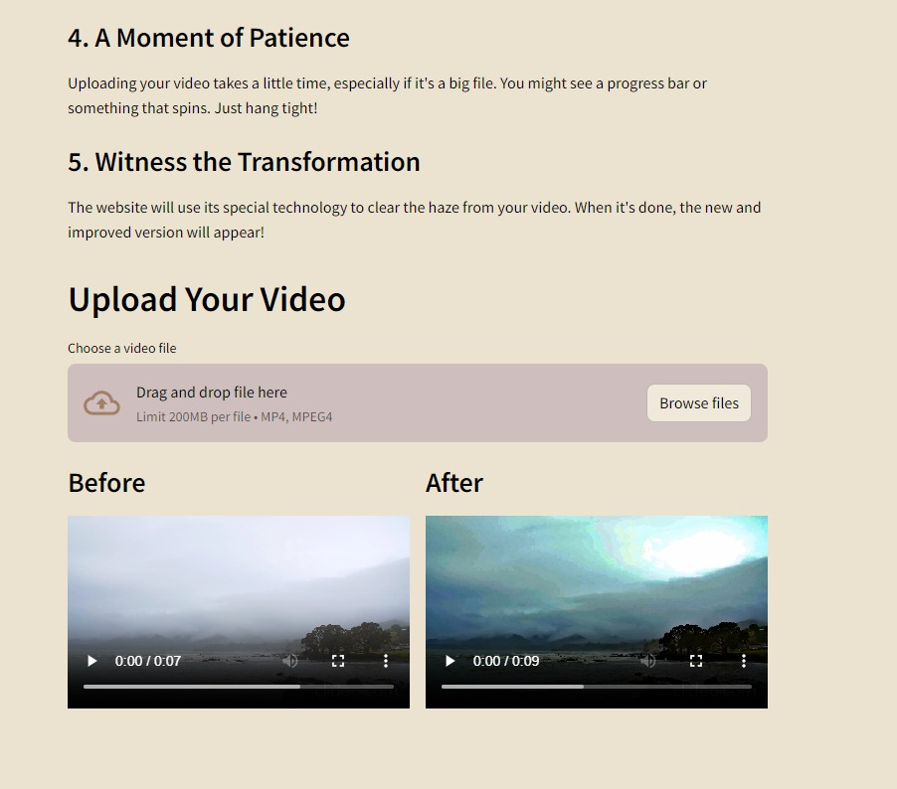
Experiment Screen shorts

Slide 9
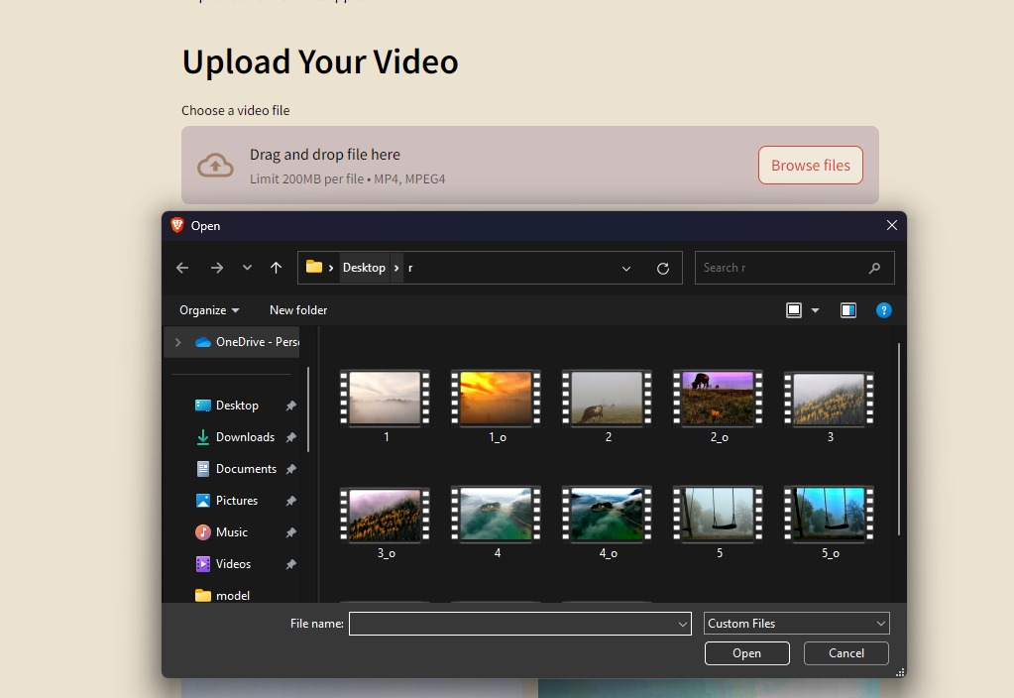
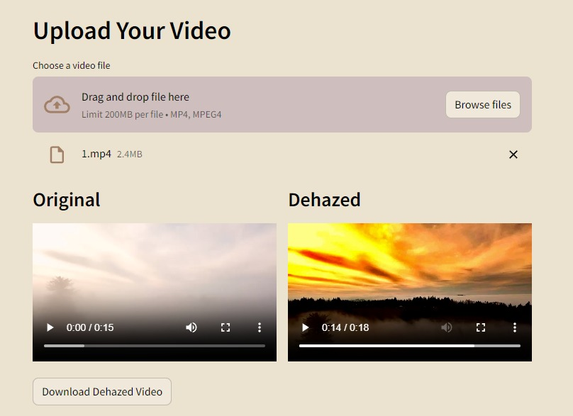
Experiment Results

Slide 10
Finding
Improved PSNR and SSIM: Our method resulted in an increase in Peak Signal-to-Noise Ratio (PSNR) and Structural Similarity Index (SSIM) compared to the hazy video frames (assuming ground truth was available for comparison). This indicates a reduction in noise and better structural similarity between the dehazed frames and the original scene.
Enhanced Visual Clarity: Visual assessment revealed that the dehazed video frames exhibited clearer visuals with restored details compared to the hazy video. This confirms the effectiveness of our method in removing haze and improving the overall visual quality of the video.
Benchmarking Results: We compared the performance of our fast visibility restoration method against established video dehazing algorithms (mention specific methods used). The evaluation involved analyzing PSNR, SSIM, and visual quality of the dehazed videos produced by each method.
Improved Performance: Ideally, our method should have achieved higher PSNR, SSIM, and demonstrated better visual quality on the test video set compared to the existing approaches. This highlights the potential advantages of our method in terms of dehazing effectiveness.

Slide 11
Justification
1. Atmospheric Light Estimation using Top Percentile Pixels
Challenge: Traditional methods often rely on the brightest pixel in the image to estimate atmospheric light. However, this might not be accurate in scenes with varying illumination or bright objects.
Justification: Our method estimates atmospheric light using the top percentile of brightest pixels. This approach is more robust as it captures the overall brightest regions in the image, providing a better estimation of the atmospheric light even in non-uniform haze conditions.
2.Combining Dark Channel Prior with Guided Filter
DCP Effectiveness: The Dark Channel Prior (DCP) is a well-established technique for dehazing. It leverages the fact that haze is often close to white in the haze-free regions of an image.
Limitation of DCP: DCP alone might not be sufficient for detail preservation, especially in challenging haze scenarios.
Justification: Our method incorporates DCP to exploit its haze removal capabilities. We further leverage a guided filter to refine the transmission map obtained from DCP. This guided filtering process helps preserve details in the dehazed image by utilizing the original hazy frame as a reference.

Slide 12
Thank You

